Slide 1
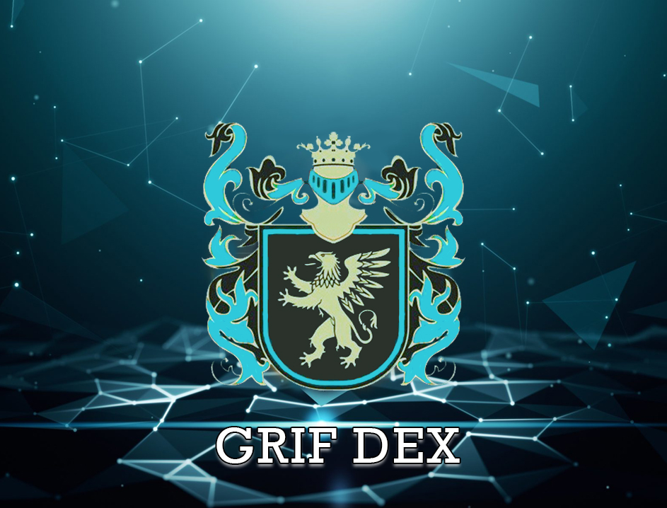

Slide 2
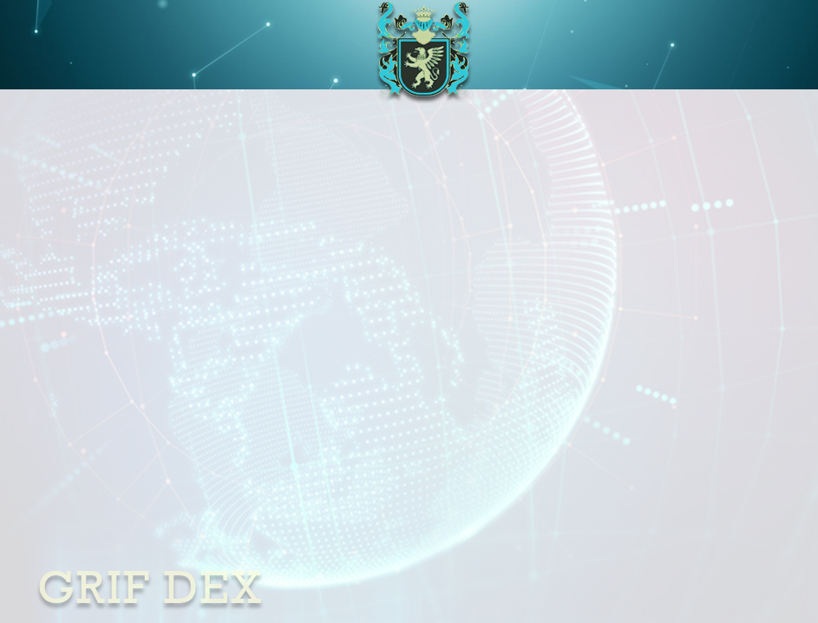
GRIF DEX is an international decentralized exchange, a trading platform where you can buy and sell coins, tokens and fiat currency. An exchange will conform to the requirements of both private and institutional participants of financial market and professional traders. Innovative decisions for an individual user, business, organizations, traders and investors. To date at the market of cryptocurrencies of similar exchanges does not exist. A special feature of GRIF DEX will be the integration of coins, tokens, and fiat currency on one decentralized trading platform. We worked out the mechanisms of cooperation of different from each other networks of blockchain in one decentralized environment. GRIF DEX guarantees freedom and fair solution of all user’s questions. Security of funds is based on several components: 1) The deposit is on the user's devices. 2) Financial risks are determined within the system. The participant chooses where and on what terms to trade. 3) You assess the risks yourself, as you fully own your own funds. 4) Users will be able to trade any trading pair directly without the need to conduct a transaction through an intermediate currency or do any other actions.

Slide 3
The exchange will seriously compete with existing platforms in terms of speed and security. The technology, which will be equipped with the system, means that applications are coordinated in real time, and also confirmed within a few seconds. This is a great advantage of the exchange-participants do not need to wait for the next block to find out whether the transaction was successfully executed or not. Complete freedom of users - for realization of transactions no permissions and mediators will be required. All will take place without participation of the third persons. Public key encryption, and distributed user base. The GRIF DEX network can exist between two connected computers - with each individual network unit storing a copy. This will make GRIF DEX literally indestructible - no one will be able to change the public record. Highly transparent distributed network protected by current cryptography, to ensure the highest security of the register. This is a huge advantage of blockchain technology and before banking systems with a human factor, and before centralized digital registers like Quick Books or Quicken. Main advantage of GRIF DEX for users is the protection of turnover means. This was made possible by the consensus algorithm that regulates the mutual settlements between the decentralized chain of master-nodes and network participants. User funds entered into the system are stored on real accounts of the master node. Thus for providing of security of storage of facilities the resources of user are used or the special depository is given at choice with the mortgage providing. GRIF DEX will focus on traders, giving them the opportunity to use various professional trading software.

Slide 6
Demo version of GRIF DEX will be released 02.02.2020. In the near time will be presented White - Paper, and also complete technical information. In online mode, you can track the progress of the road-Map stages. We do not plan to conduct ICO and issue tokens. Financing of the development will be carried out at the expense of own funds of group company GRIF. All our projects are financed by INVESTCOIN sales. Use and develop INVESTCOIN. Support the development of our PROJECTS!

